Slide 1
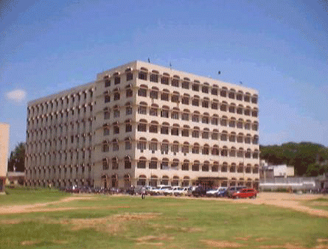

Department of Computer Science Engineering
Deccan College of Engineering and Technology
(Affiliated to Osmania University) Hyderabad

Slide 2

Project on
CARE & CURE HOSPITAL
Submitted in partial of the requirements for the award of the degree of
BACHELOR OF ENGINEERING
IN
COMPUTER SCIENCE AND ENGINEERING
BY
Ashna Manzoor 160319733002
Syeda Aimen Fatima 160319733011
Amina Amatur Rahman Siddiqui 160319733014
Under the guidance of
Ms.Afroze Begum

Slide 3

CARE & CURE HOSPITAL

Slide 4
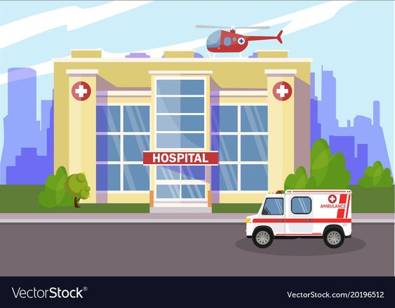
INTRODUCTION
Care & Cure Hospital is a project which aims to maintain a computerized system of all the information of hospital entities.
hospital management is the process where health care providers effectively and efficiently administrate everything from patient to managing details .
admin modules are managing patient , doctor, appointment scheduling .
Patient module can view the appointment ,view prescription , doctor module can view the patient details.
overall in our project , we have tried to overcome and simplify few features and make the website user friendly so that its implementation in hospitals is easier for health care.

Slide 5
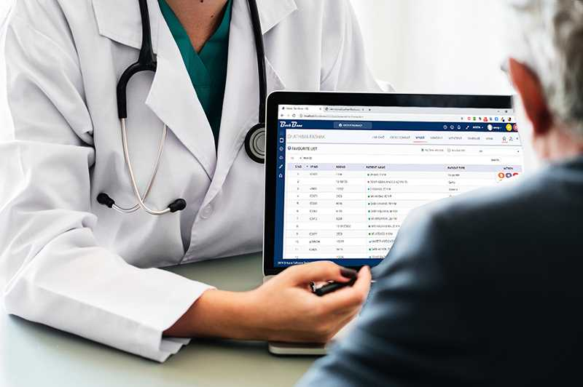

OBJECTIVE
The main objective of our project “Care & Cure Hospital” is to manage the record of patients, doctors and appointments .The project aimed to develop to maintain day to day activities and keep records.
It is designed to achieve the following objectives :
To computerize all details regarding patient & doctors as well as the hospital.
Scheduling the appointment of patient with doctors to make it convenient for both.
The information must be kept up to date and there record should be kept in the system for historical purpose.
Reduce the paper work and provide the 24/7 accessible website with user-friendly GUI (Graphical User Interface) to manage the records.

Slide 6

SCOPE
The scope of the project can be summarized as follows:
The proposed software product is the “Care & Cure Hospital”.
The system will be used in hospital to get the information from the patients and then storing that data for future usage.
The current system in use is paper-based system. It is too slow and cannot provide updated lists of patients within a reasonable timeframe.
The intention of the system is to reduce over-time pay and increase the number of patients that can be treated accurately.

Slide 7
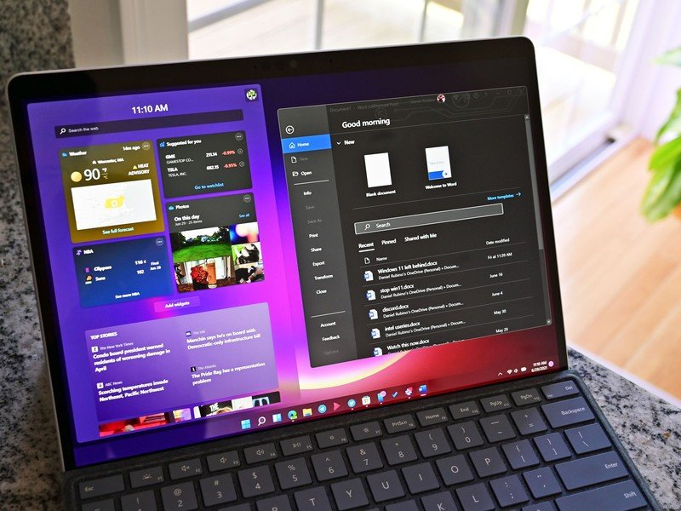
SOFTWARE REQUIREMENTS
Software requirement is defined as the required specifications a device must have in order to use certain software.
A software requirements specification (SRS) is a document that captures complete description about how the system is expected to perform. It is usually signed off at the end of requirements engineering phase.
SOFTWARE INTERFACES
Operating System – WINDOWS 11
Database(backend) – MYSQL, PYTHON
Frontend - HTML

Slide 8

HARDWARE REQUIREMENTS
The hardware requirements are the requirements of a hardware device.
Most hardware only has operating system requirements or compatibility.
For example, a printer may be compatible with Windows XP but not compatible with newer versions of Windows like Windows 10, Linux, or the Apple mac OS .
HARDWARE INTERFACES
PROCESSOR - Pentium-IV (or) Higher
RAM- 5 12 MB (or) above
HARD DISK- 40GB (or) above
INPUT DEVICES - Keyboard, Mouse
OUTPUT DEVICES- Monitor

Slide 9
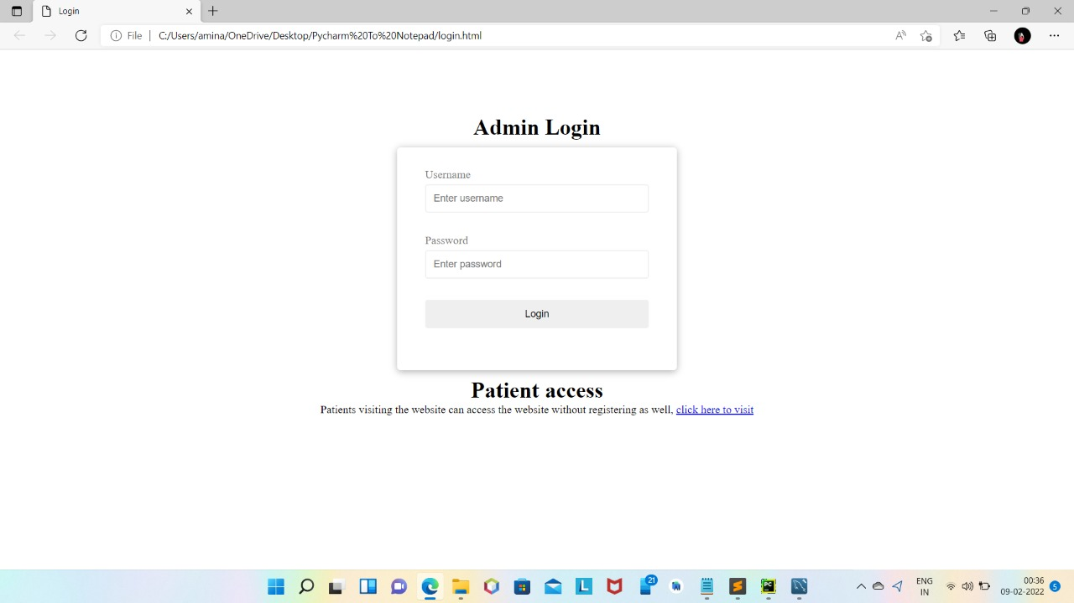
MODULE-1 LOGIN PAGE

Slide 10
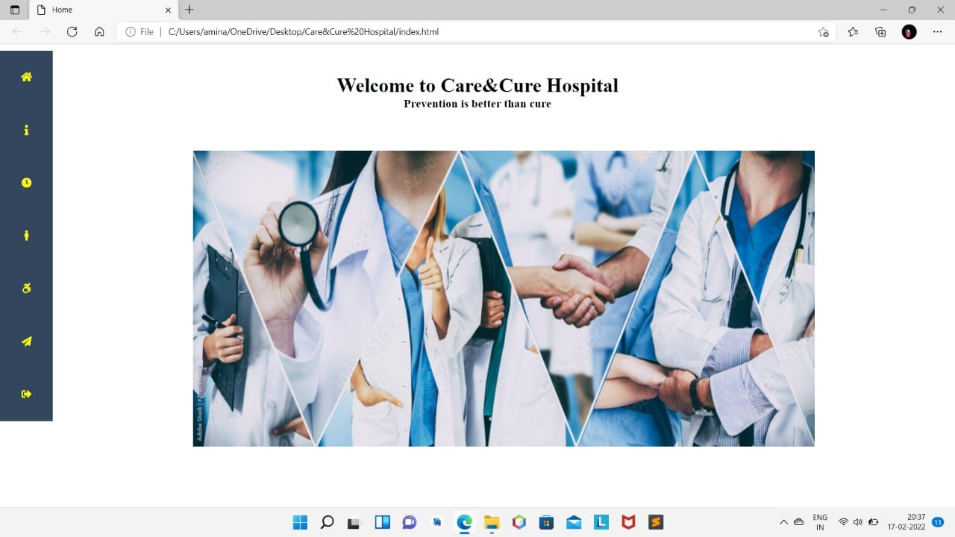
MODULE-2 HOME PAGE

Slide 11
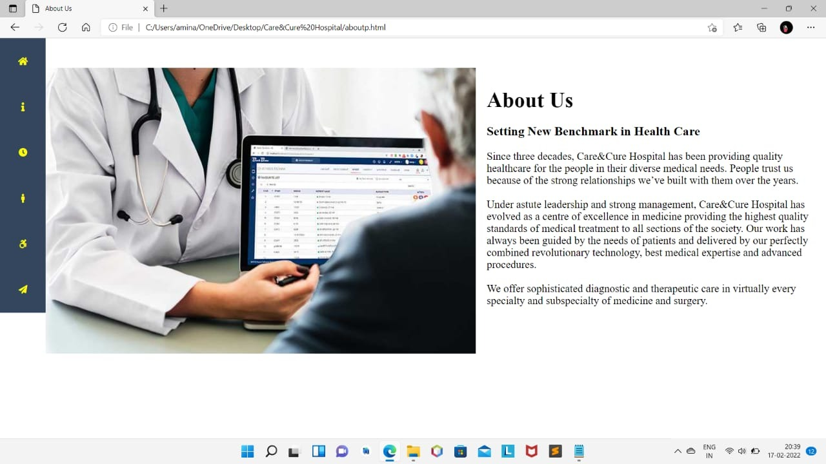
MODULE-3 ABOUT US PAGE

Slide 12
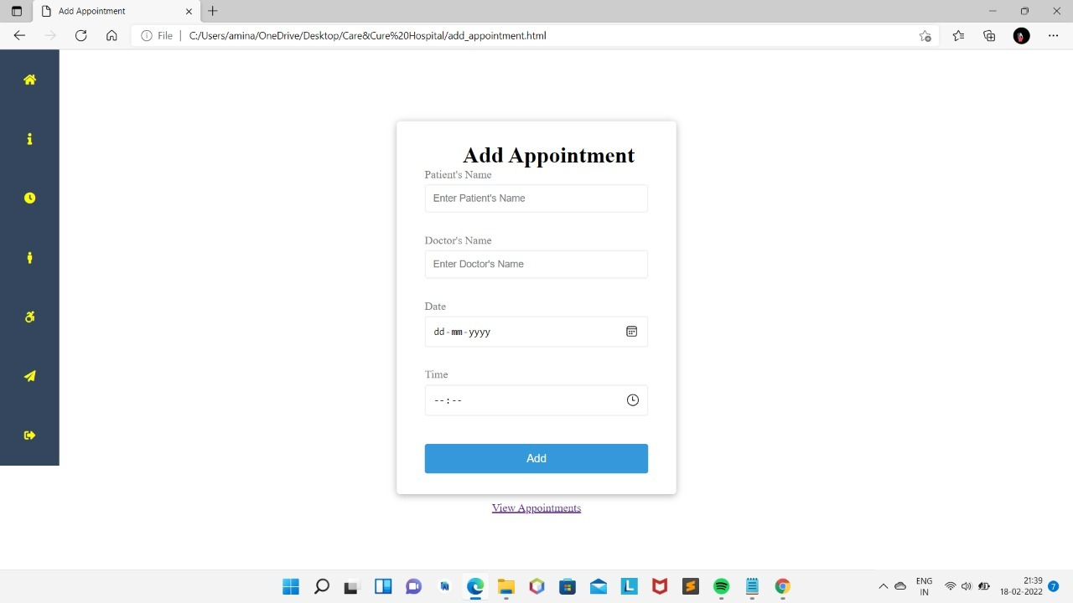
MODULE-4 ADD APPOINTMENT

Slide 13
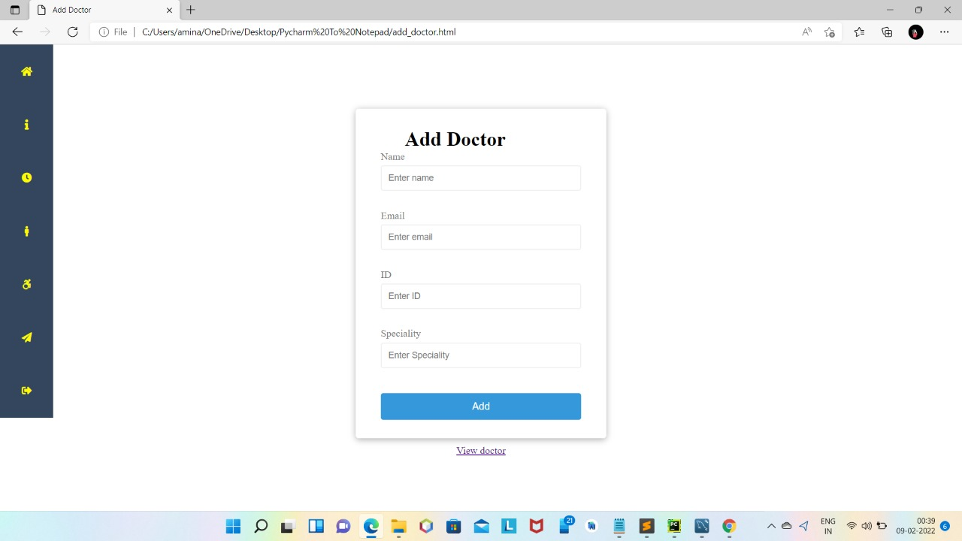
MODULE-5 ADD DOCTOR

Slide 14
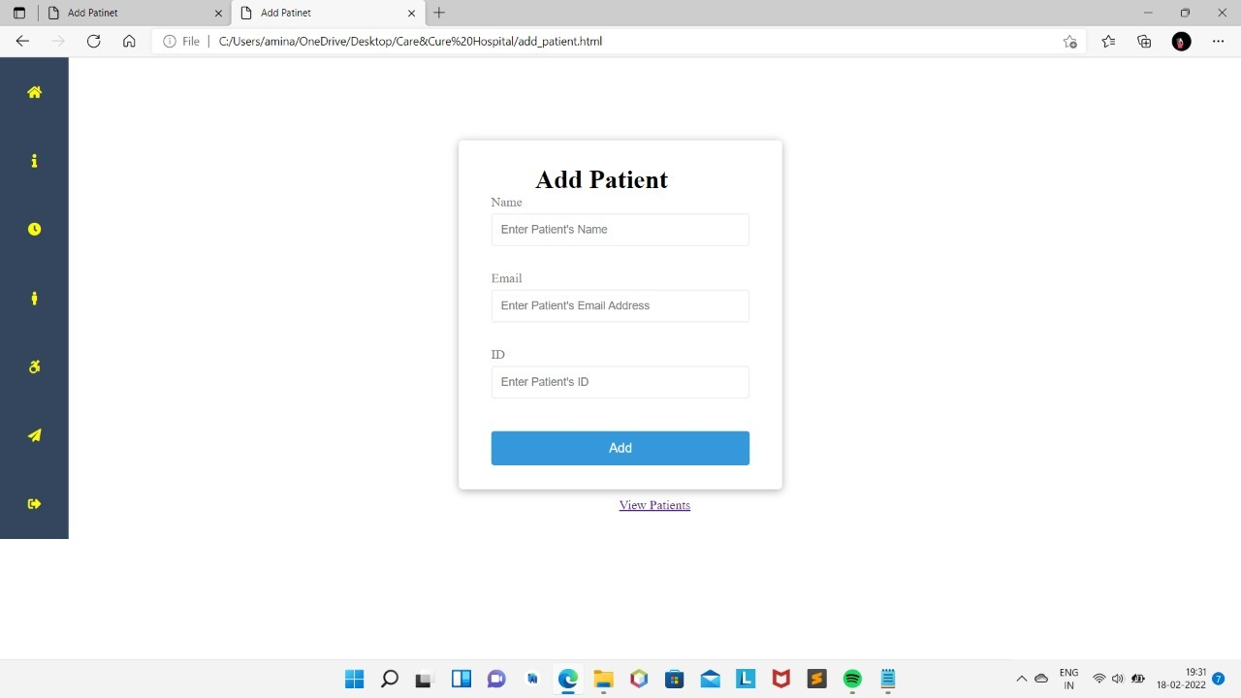
MODULE-5 ADD PATIENT

Slide 15
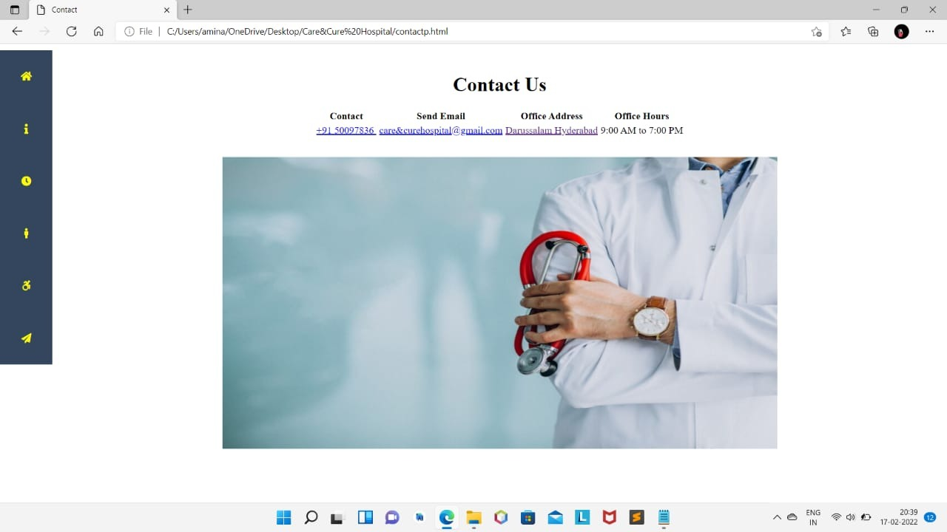
MODULE- 6 CONTACT US PAGE

Slide 16

FUTURE ENHANCEMENT
The proposed system is Hospital Management System. We can enhance this system by including more facilities like pharmacy system for the stock details of medicines in the pharmacy. Providing such features enable the users to include more comments into the system.
Daily functions like monitoring blood bank and overall management of various departments can be easily performed with higher accuracy after the installation of hospital software.
LIMITATIONS
The size of the database increases day-by-day, increasing the load on the database back up and data maintenance activity.
Training for simple computer operations is necessary for the users working on the system.

Slide 17
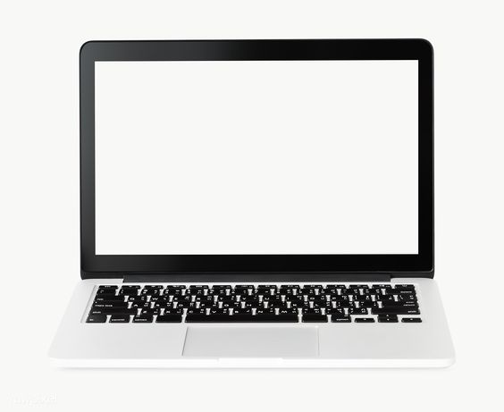
CONCLUSION
The project Hospital Management System (HMS) is for computerizing the working in a hospital. It is a great improvement over the manual system. The computerization of the system has speed up the process. In the current system, the front office managing is very slow. The hospital managing system was thoroughly checked and tested with dummy data and thus is found to be very reliable.
The software takes care of all the requirements of an average hospital and is capable to provide easy and effective storage of information related to patients that come up to the hospital.
It generates test reports and also provides the facility for searching the details of the patient. It also provides billing facility on the basis of patient's status whether it is an indoor or outdoor patient. The system also provides the facility of backup as per the requirement.

